Slide 1

Weather App
Done by
- R Prudhvi Raj

Slide 2

Introduction
In this article we’ll build a simple Django app that displays the current weather for various cities. To get the current weather data, we’ll use the Open Weather Map API.
What exactly is Django?
Django is a high-level Python web framework that enables rapid development of secure and maintainable websites. Built by experienced developers, Django takes care of much of the hassle of web development, so you can focus on writing your app without needing to reinvent the wheel.

Slide 3

Using the Weather API
What we want to do now is sign up for the Open Weather Map API. This will allow us to get real-time weather for any cities that we add in our app.
Go to the site, create an account and then go to the API keys on their dashboard. Enter a name and generate a new API key. This key will allow us to use the API to get the weather.
The one endpoint we’ll use is below, so you can see the data that gets returned by modifying the following URL with your API key and navigating to the URL in your browser. It may take a few minutes for your API key to become active, so if it doesn’t work at first, try again in after a few minutes.
Finally, we’ll send the request to the URL using the city and get the JSON representation of that city. If we print that to the console we can see the same data we saw when we put the URL in our address bar.
If you start your server again and reload the page, you’ll see the data get printed to your console.

Slide 4



Requirements
Hardware :-
OS: Microsoft® Windows® 2000/XP.
Processor: 800 MHz Intel Pentium III or 800 MHz AMD Athlon.
Memory: 128 MB of RAM.
Software:-
Pycharm
Python 3.6
Django

Slide 5
Installation
Installing Django is like installing any other Python library: you can start a virtual environment and run pip to install Django.
pip install Django - This will install the latest version of Django for you.
pip install requests – This install requests
Once you have Django installed, create and navigate to a directory for this project if you haven’t already. Once there, you can run the startproject command that Django gives you to generate the project.
django-admin startproject the_weather - Django should have created a few new files in your directory.
Let’s try starting up our development server. To do that, navigate to the new directory and use manage.py to run the runserver command in your terminal:
python manage.py runserver
If you look at your terminal, you should see the URL for your app. By default it should be 127.0.0.1:8000. Open up your browser and go to that URL.

Slide 6
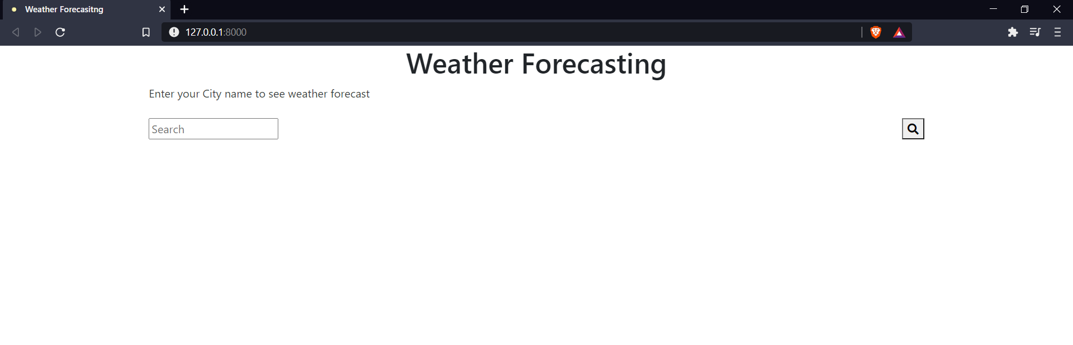
Output

Slide 7
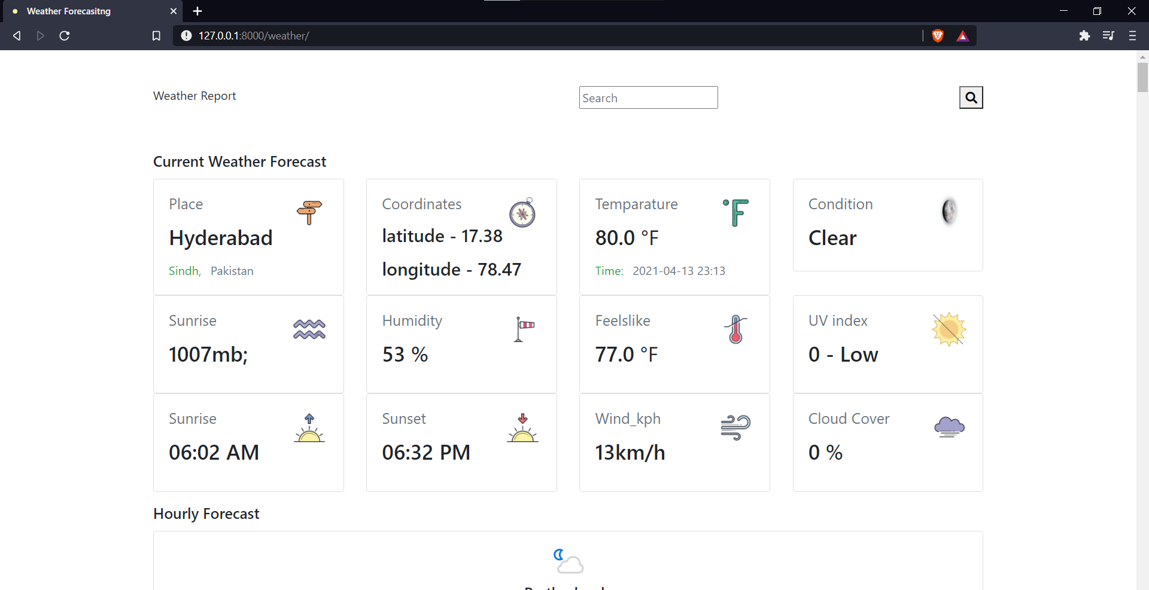

Slide 8

Conclusion: Now we have a way to keep track of the weather for multiple cities in our app. In this project, we had to work with various parts of Django to get this working: views, models, forms, and templates. We also had to use the Python library requests to get the actual weather data. So even though the app is simple, you’ll use many of the same concepts in apps with more complexity.

Slide 9
Thank You

